Slide 1

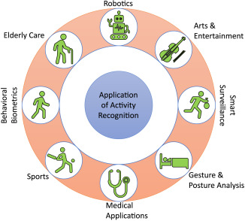
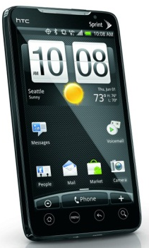
Human Activity analysis using machine learning classification techniques
SRI SIVANI COLLEGE OF ENGINEERING
Using smartphone Dataset
Notes:
Jay

Slide 2
Submitted by
M.Jyotsna(20W61A0552) Under the guidance of
J.Sai(20W61A0532) Mr M.Murali Krishna
R.Harsha vardan(20W61A0568) Asst.prof
S.Bhagya raj(20W61A0574)
K.Santosh kumar(21W65A0504)

Slide 3
Abstract
Human activity analysis is gaining importance because of its implication in remote monitoring application including security, health and fitness apps. an analysis of different machine learning techniques for recognizing human activity.
Threshold-based algorithm is simpler and faster which is often applied to recognize the human activity. But Machine algorithm provides the reliable result. Numerous sensors have been deployed to observe the human dynamic characteristics.
Four distinct machine learning techniques were applied on the dataset, namely, linear regression, logistic regression, support vector machine and neural network.

Slide 4
Introduction
Using sensors to identify human activities.
Motivation
Human survey (study human daily activities)
Medical care (diabetes, elderly, rehabilitation)
Smartphone is small and convenient to carry around and its computational resource is powerful enough for our purpose.
Notes:
Jay

Slide 5
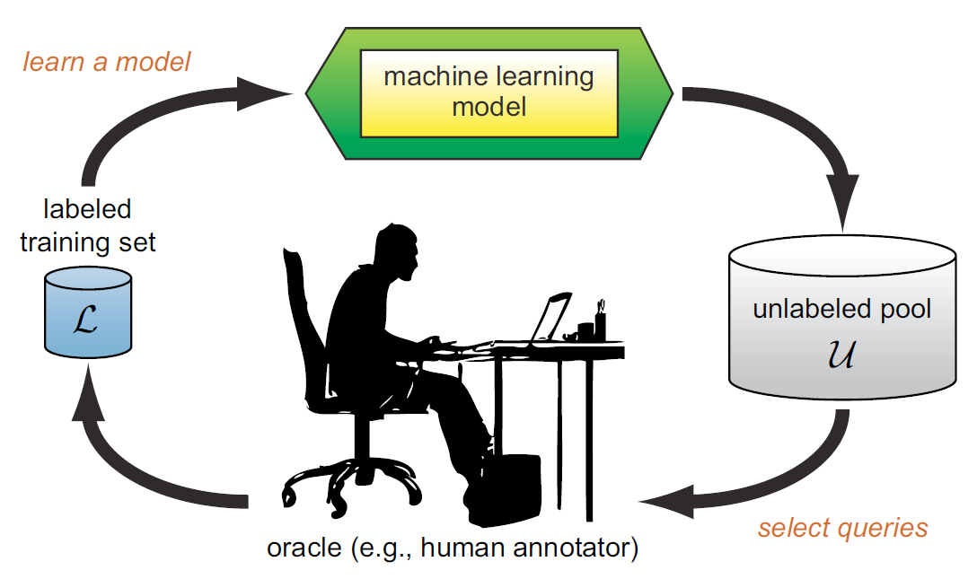
Active Learning
We can achieve greater accuracy with fewer training labels if we choose the data from which we learn.
Motivation: To minimize the time and labor for labeling abundant data
Notes:
Jay

Slide 6
Basic Human Activities
Gestures: Basic movements of a persons body parts, Raising an arms
Lifting a leg.
Actions: A single persons activities which could entail multiple gestures. Walking, Waving hands.
Interactions: Interactions that involve two or more People / items.eg:Two People fighting
Group activities: Activities performed by multiple people.
Eg:A group running, A group walking,A group fighting

Slide 7
Problems of traditional method
Recognizing activity through computer vision methods has limitations due to lightening, accurate foreground extraction technique and most importantly the person to be monitored needs to be in camera range of vision
Major challenge is that human body activities are very complex and its real-time recognition is very difficult.
To overcome this challenge machine learning is applied on sensors data like accelerometer data.

Slide 8
Literature review
Install multiple inertial sensors on the body. [1, 2, 3,4]
A mixture between vision-based and inertial sensor system.[7]
Classifiers such as Bayesian Decision Making, KNN, SVM, ANN were studied before. [10,11]
Features from time domain, frequency domain and wavelet analysis have been studied.[8,9]
Automatic extraction of discriminating features is described in the paper [5]
The data taken is recorded from mobile phone accelerometer which is placed in person’s pocket and hand. In the paper [6]
Notes:
Jay No one has applied active learning to this problem

Slide 9
Methods
Classification Techniques
Random forest
Support Vector Machines
Logistic regression
Artificial Neural Networks
Query Strategies
KNN: Entropy
SVM: Distance from the boundary
ANN Discriminant function values
Notes:
Amin

Slide 10
OBJECTIVES
The primary objective of this project is to develop a robust system for human activity analysis using smartphone datasets and machine learning classification techniques.
Specifically, the project aims to Explore various machine learning classification algorithms to identify the most suitable approach for activity analysis.
Train and evaluate the selected classification model using labeled smartphone dataset.
Evaluate the performance of the developed system on different datasets and real-world scenarios.

Slide 11
METHODOLOGY
There is various software development approaches defined and designed which are used/employed during development process of software, these approaches are also referred as "Software Development Process Models".
Each process model follows a particular life cycle in order to ensure success in process of software development.

Slide 12
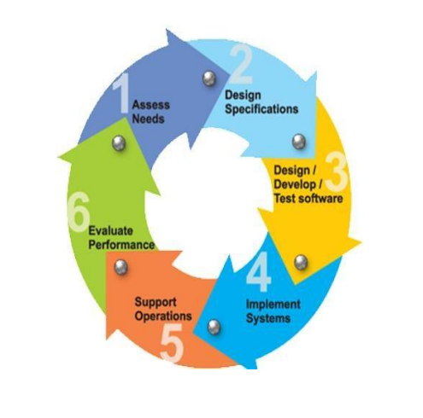

Slide 13
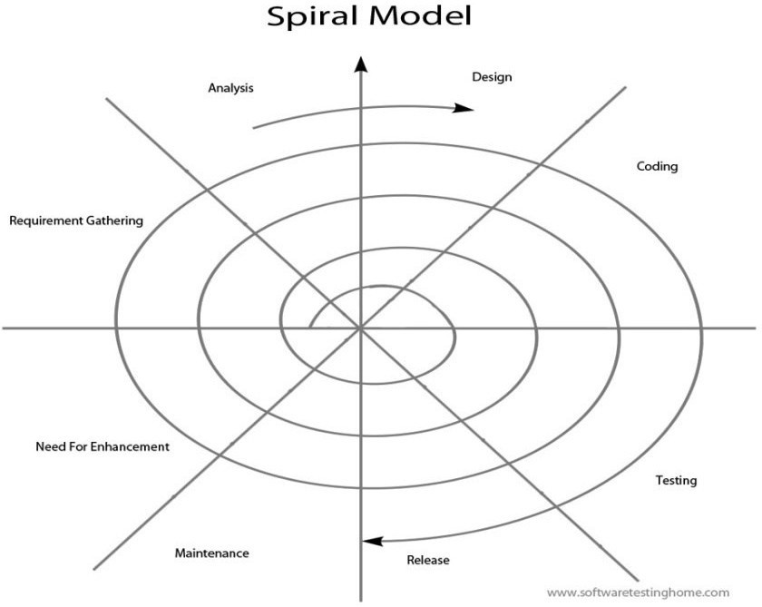
PROCESS MODEL

Slide 14
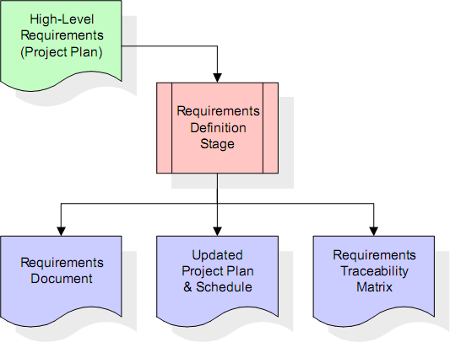
Requirements Definition Stage and Analysis

Slide 15
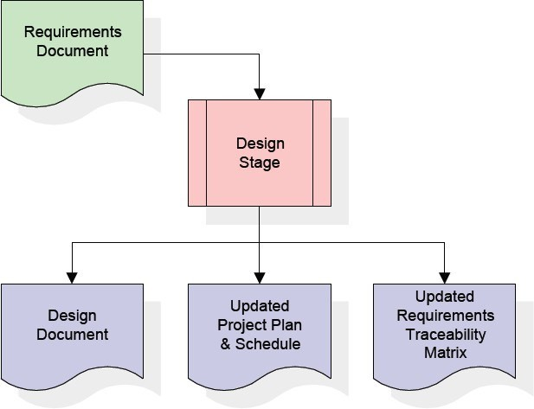
Design Stage

Slide 16
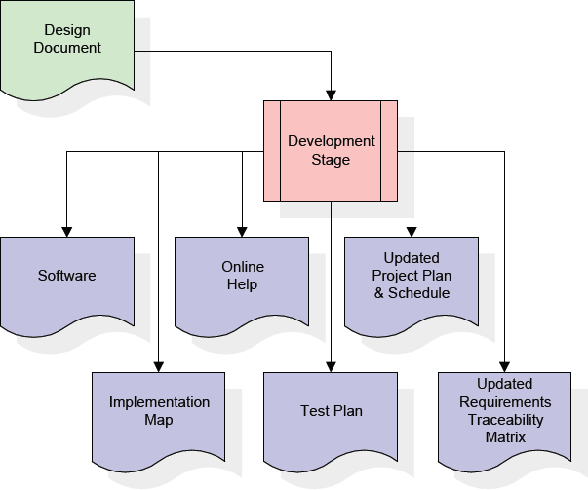
Development Stage

Slide 17
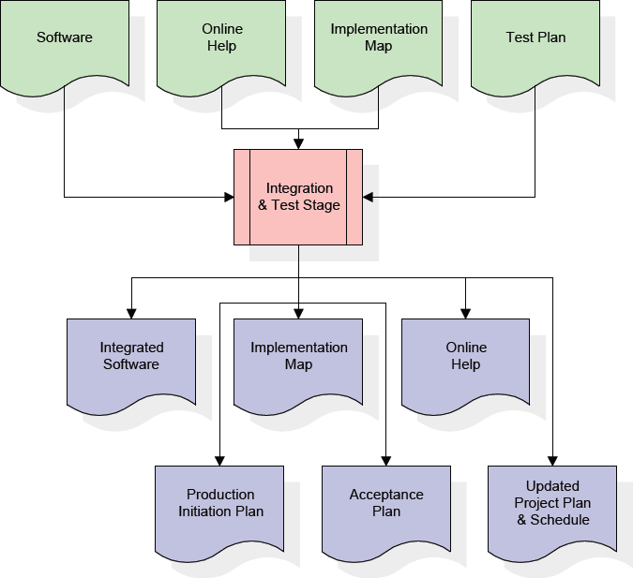
Integration & Test Stage

Slide 18
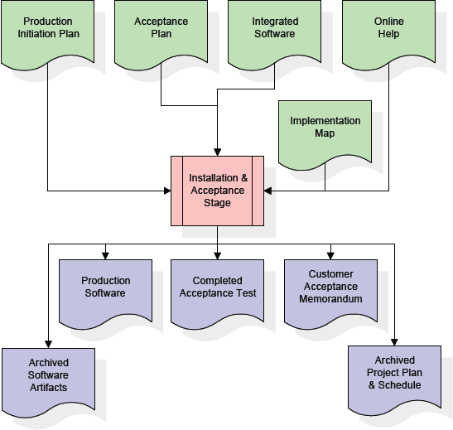
Installation & Acceptance Stage

Slide 19
Technologies Used
Machine learning: ML is a branch of artificial intelligence (AI) that enables computers to “self-learn” from training data and improve over time, without being explicitly programmed. Machine learning algorithms are able to detect patterns in data and learn from them, in order to make their own predictions.
In short, machine learning algorithms and models learn through experience

Slide 20
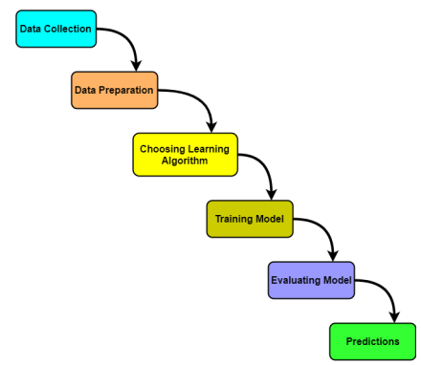
Work flow of machine learning model

Slide 21
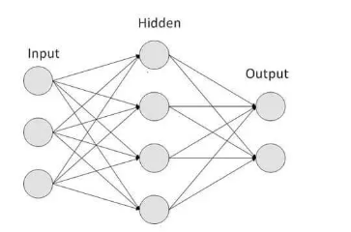
Neural networks
A neural network is a method in artificial intelligence that teaches computers to process data in a way that is inspired by the human brain.

Slide 22
SYSTEM DESIGN
Use-case diagram
Reading dataset
Metrics
Preprocessing
Feature Selection
NewClass
Data Spliting
Training
Testing

Slide 23
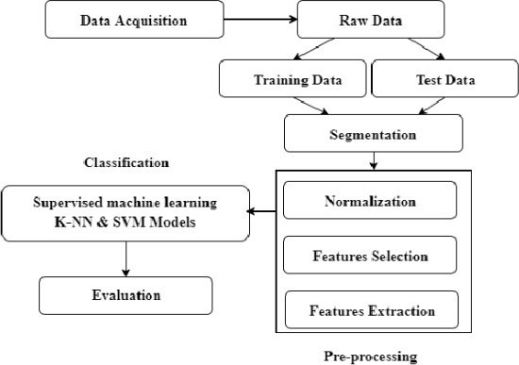

Slide 24
Implementation
1. Data Collection Module
2. Data Preprocessing Module
3. Feature Extraction Module
4. Machine Learning Model Training Module
5. Model Evaluation Module
6. Real-Time Monitoring Module
7. Deployment and Integration Module

Slide 25
Data Collection
Smartphone
Sensor: 3D accelerometer,50 Hz
Cellphone in pockets around waist
3 people 5 activities: walking, biking, walking upstairs, walking downstairs, jogging, limping
Notes:
Jay

Slide 26
Data preparation Module:
This module preprocesses the raw sensor data to make it suitable for input to the machine learning models. Preprocessing tasks may include filtering, noise removal, feature extraction, normalization, and segmentation of the data.

Slide 27
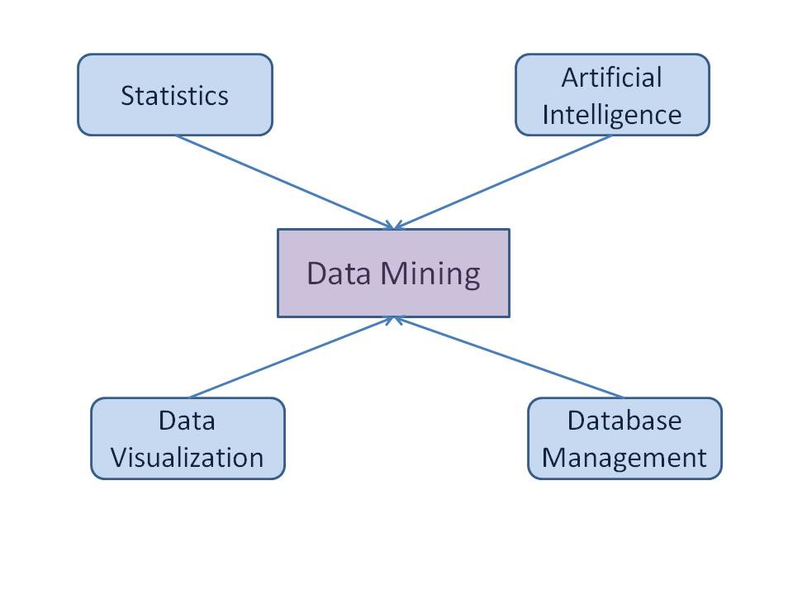
Data Mining

Slide 28
Patterns in Data Mining
1.Association
2.Classification
3.Regression
4.Cluster analysis
5.Forcasting

Slide 29
Feature Extraction Module:
Feature extraction is crucial for capturing relevant information from the raw sensor data. This module extracts meaningful features from the preprocessed data, such as statistical features (mean, standard deviation), frequency-domain features (FFT coefficients), time-domain features (temporal patterns), or domain-specific features (e.g., analysis features for motion data).

Slide 30
Machine Learning Model Training Module:
This module trains machine learning models to recognize and classify human activities based on the extracted features. It involves selecting appropriate algorithms (e.g., SVM, Random Forest, Neural Networks) and optimizing their parameters using techniques such as cross-validation and hyperparameter tuning.

Slide 31
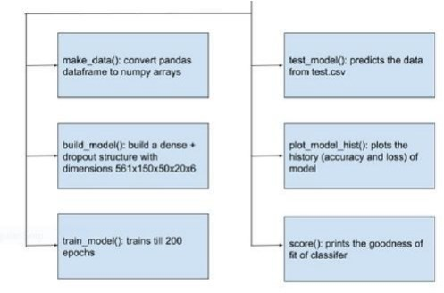
Model Evaluation Module
After training the machine learning models, this module evaluates their performance using evaluation metrics such as accuracy, precision, recall, F1-score, and confusion matrices. It may involve splitting the data into training and testing sets, performing cross-validation, and analyzing model performance on unseen data.

Slide 32
Real-Time Monitoring Module
This module enables real-time monitoring of human activities using the trained machine learning models. It processes incoming sensor data streams, applies the trained models for activity recognition, and provides feedback or alerts based on detected activities. It may also include components for visualizing activity data in real-time.

Slide 33
Deployment and Integration Module
This module focuses on deploying the activity analysis system in production environments and integrating it with existing systems or platforms. It may involve packaging the system components into deployable containers, configuring cloud infrastructure, and ensuring interoperability with other software systems or APIs.

Slide 34
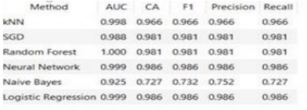
RESULTS &DISCUSSION

Slide 35
Applications
Healthcare Monitoring:
Remote patient monitoring, fall detection, activity recognition, etc.
Smart Homes:
Home automation, energy management, elderly care, etc.
Retail Analytics:
Customer behavior analysis, foot traffic monitoring, product placement optimization, etc.
Security and Surveillance:
Intrusion detection, suspicious behavior recognition, crowd monitoring, etc.
Sports Performance Analysis:
Athlete training monitoring, biomechanical analysis, injury prevention, etc.

Slide 36
ADVANTAGES:
Cost-Effective Solution
Scalability and Accessibility
Health Monitoring and Wellness Management
Research and Innovation
DISADVANTAGES:
Model Complexity and Interpretability
Overfitting and Performance Degradation
Battery Consumption

Slide 37
Conclusions
Increasing amount of work is being done to correctly identify Human Activity as it has many important applications. Using accelerometer data to recognize human activity is very convenient compared to classic ways recognition because it is in-expensive and mobile.
Accelerometers are installed in all modern smartphones and is available everywhere. An accelerometer can also be embedded in a device other than smartphones. Recognizing activity in real time is great challenge which can be achieved efficiently only through using machine learning techniques.

Slide 38
Future Scope
Advanced Machine Learning Techniques
Multimodal Sensor Fusion
Context-aware Activity Recognition
Edge Computing and IoT Integration
Healthcare and Well-being Applications
Privacy-preserving Techniques
Personalized Feedback and Intervention
Integration with Wearable Devices and Smart Environments
Longitudinal Studies and Population Health Monitoring

Slide 39
REFERENCES
1. Davide Anguita, Alessandro Ghio, Luca Oneto, Xavier Parra, Jorge L. Reyes-Ortiz(2012). Human Activity Recognition on Smartphones Using a Multiclass HardwareFriendly Support Vector Machine. Springer International Workshop on Ambient Assisted Living.Lecture notes in Computer Science. Vol(7657), pp 216- 223.
2. Jun Liu, Amir Shahroudy, Dong Xu, Gang Wang(2016). Spatio-Temporal LSTM with Trust Gates for 3D Human Action Recognition. European Conference on Computer Vision., pp 816-833. Vol(9907) Oyelade, Oladipupo, Obagbuwa(2010). Application of k-Means Clustering algorithm for prediction of Students’
Academic Performance. International Journal of Computer Science and Information Security,7(1).292-295

Slide 40
Thank you!

